Slide 1



Jenson USA - Company Overview
A Data Analysis Project
Submitted By:- Md Pravez Alam

Slide 2


Introduction to Jenson USA
Jenson USA is a leading American bicycle retailer specializing in bikes, parts, and accessories. Founded in 1994, it has grown into a top e-commerce and offline cycling brand, offering high-quality products.

Slide 3

Company Overview
• Founded: 1994
• Headquarters: Riverside, California, USA
• Industry: E-commerce & Retail (Cycling)
• Products: Bicycles, parts, accessories, apparel
• Sales Channels: Online store & retail outlets

Slide 4


Objective: This report aims to analyze sales and product performance based on various metrics, including store-wise sales, cumulative sales, top-selling products, customer spending, and staff performance. The key findings are outlined below.

Slide 5
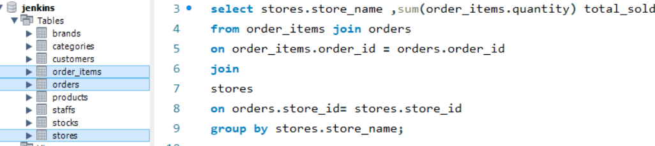





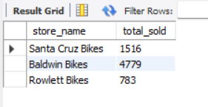
Sales Performance
1. Find the total number of products sold by each store along with the store name.
Output

Slide 6

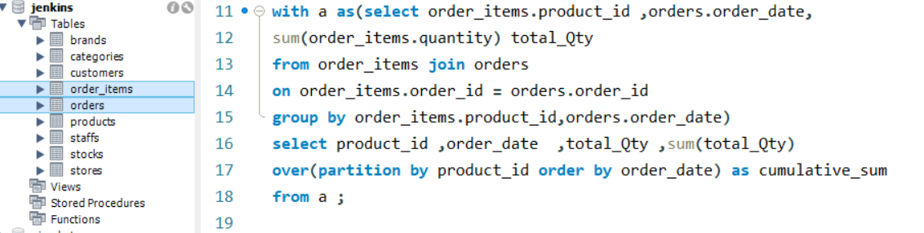

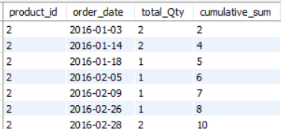
2. Calculate the cumulative sum of quantities sold for each product over time.
Output

Slide 7

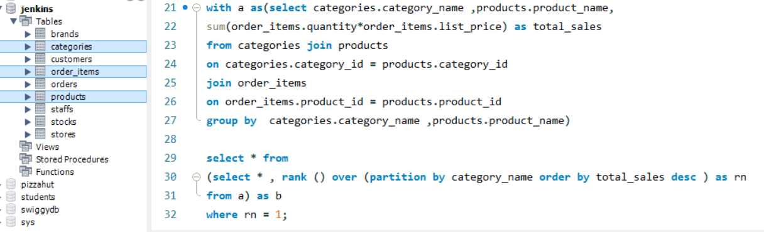
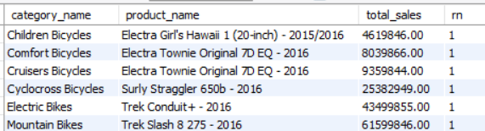
3. Find the product with the highest total sales (quantity * price) for each category.
Output

Slide 8

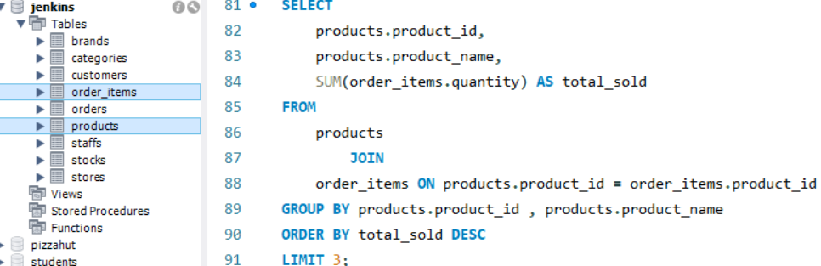
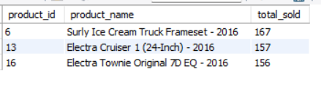
4. Find the top 3 most sold products in terms of quantity.
Output

Slide 9
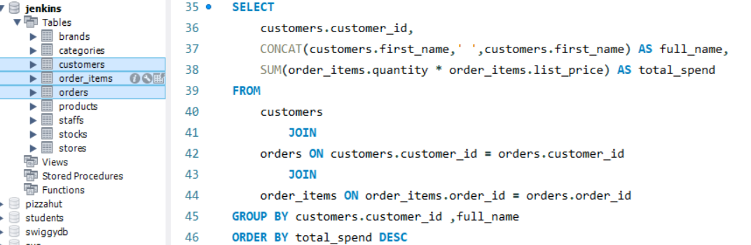
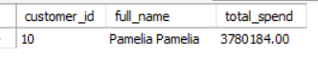
Customer and Order Insights
1. Find the customer who spent the most money on orders.
Output

Slide 10

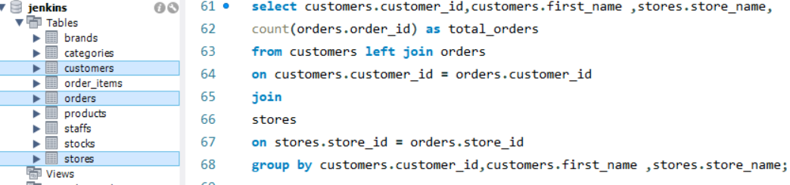
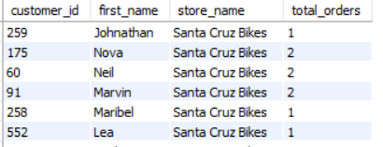
2. Find the total number of orders placed by each customer per store.
Output

Slide 11

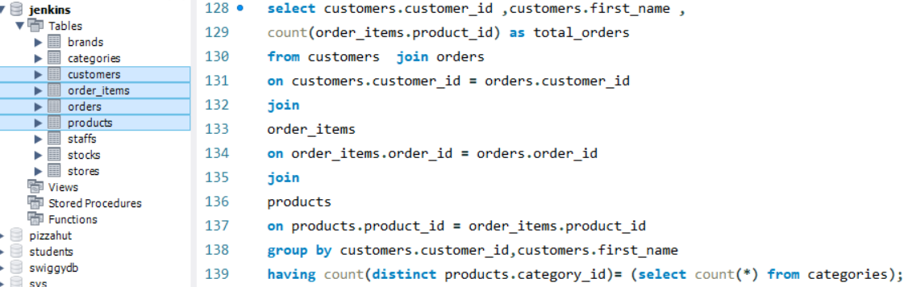
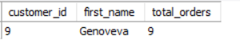
3. Identify the customers who have ordered all types of products (i.e., from every category).
Output

Slide 12

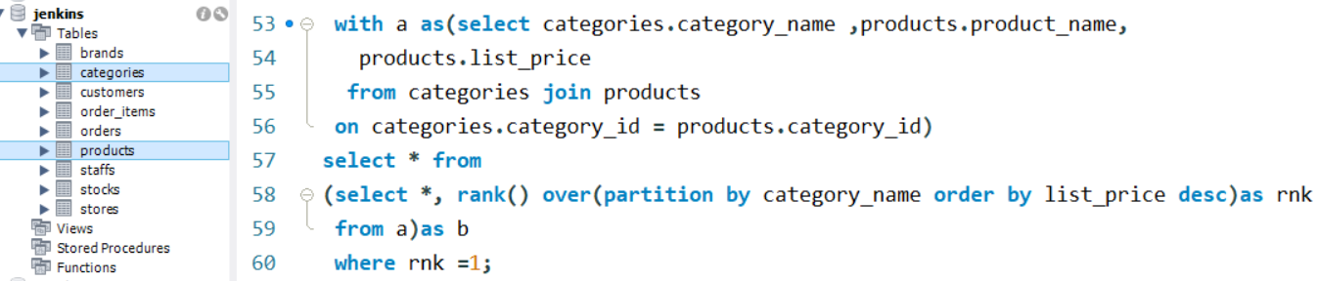
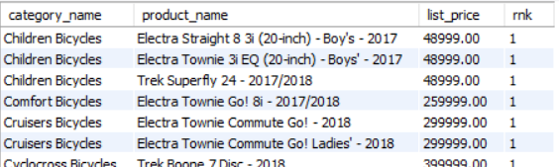
Pricing and Inventory Analysis
1. Find the highest-priced product for each category name.
Output

Slide 13

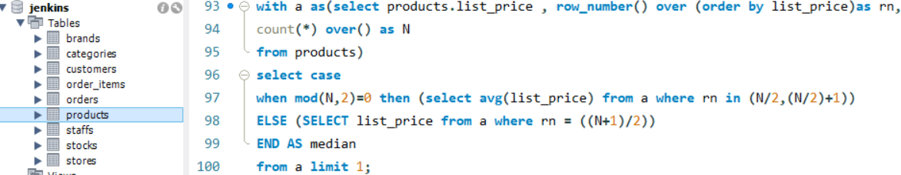
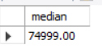
2. Find the median value of the price list.
Output

Slide 14

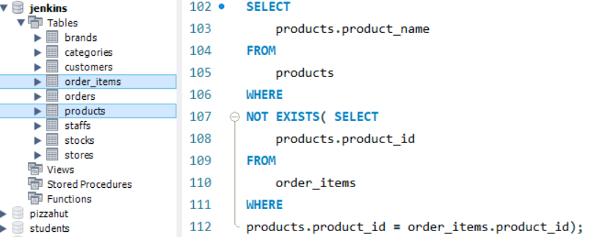
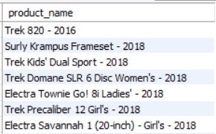
3.List all products that have never been ordered (use EXISTS).
Output

Slide 15

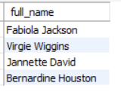
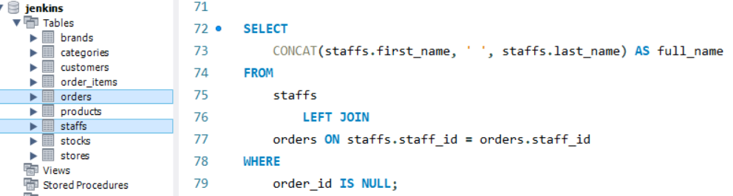
1.Find the names of staff members who have not made any sales.
Staff Performance Analysis
Output

Slide 16
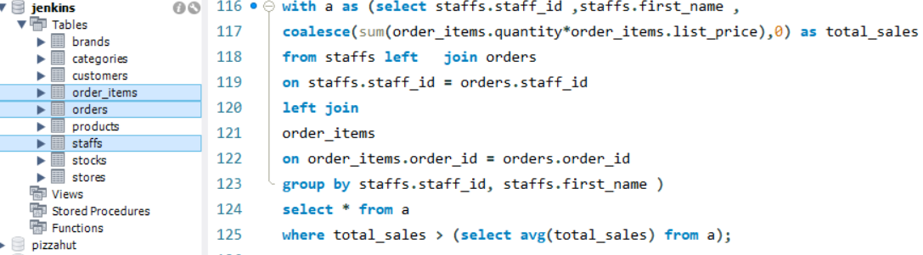
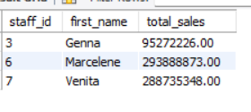
2. List the names of staff members who have made more sales than the average number of sales by all staff members.
Output
Output

Slide 17
This report provides a comprehensive analysis of sales performance, customer behavior, pricing trends, inventory efficiency, and staff contributions. By identifying key patterns and trends, businesses can make data-driven decisions to enhance sales strategies, optimize product offerings, and improve overall operational efficiency. Understanding customer preferences, monitoring staff performance, and maintaining a balanced inventory are crucial for sustaining growth and competitiveness in the market.
Conclusion

Slide 18


FOLLOW ME ON LINKEDIN TO GET MORE INFORMATION THANK YOU!

